Slide 1
Hearing God
in our daily lives
Session 2

Slide 2
Week 1 - Can We Hear From God?
Reality, Motive, Blocks to Reception

Slide 3
Homework
Sometime (3 times) get quiet before the Lord.
Read the Psalm 22, 23, 24 one each time.
Ask the Lord to speak to your heart about what you read and how it focuses on your life.
Write down what He spoke to you

Slide 4
Week 2 - Discerning the Sound
Knowing different “voices”

Slide 5
The Two Ways God
Speaks To His People?

Slide 6
God speaks to us
through His written Word?
The First Way God Speaks To His People

Slide 7
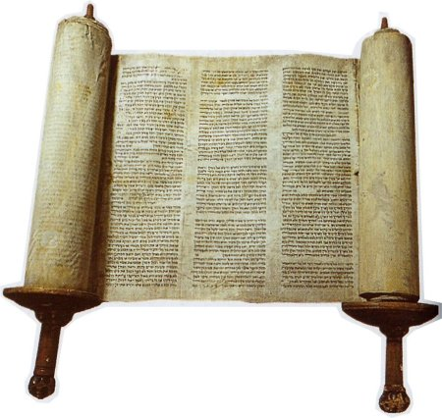
The Importance of following God’s Word
Deuteronomy 28:1-4
Your children blessed
Your work blessed
Surplus – not debt
Victory over enemies
Raised to leadership
From the
Old Testament

Slide 8
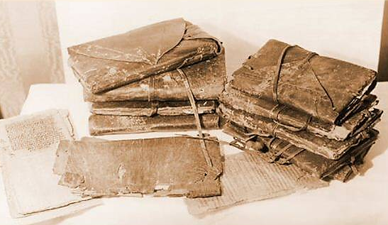
The Importance of following God’s Word
2 Peter 1:1-4
Everything needed
Very great promises
2 Peter 1:16-21
The more sure word
From the
New Testament

Slide 9
The Importance of following God’s Word
1 Timothy 3:16
All Scripture is given by inspiration of God,
and is profitable
for doctrine, for reproof, for correction,
for instruction
in righteousness
From the
New Testament

Slide 10
The Importance of following God’s Word
1 Timothy 3:16-17
that the man of God
may be complete, thoroughly equipped
for every good work.
From the
New Testament

Slide 11
God speaks to us
through the Witness of the Holy Spirit?
The Second Way God Speaks To His People

Slide 12
Witness of the Holy Spirit
But the natural man does not receive the things of the Spirit of God, for they are foolishness to him; nor can he know them, because they are spiritually discerned
1 Corinthians 2:14

Slide 13
Witness of the Holy Spirit
Romans 8:14
For as many as are led by the
Spirit of God,
these are sons of God.

Slide 14
Witness of the Holy Spirit
Romans 8:16
The Spirit Himself
bears witness with our spirit that we are children of God,

Slide 15
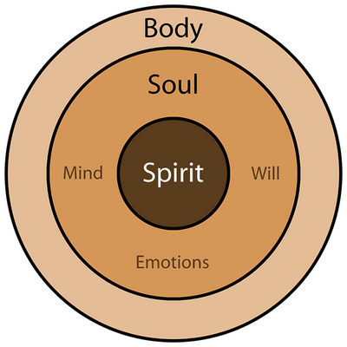
Witness of the Holy Spirit

Slide 16
Witness of the Holy Spirit
Romans 8:1-16
Matter of Life & Death

Slide 17
Witness of the Holy Spirit
Romans 8:1-4
No Condemnation

Slide 18
Witness of the Holy Spirit
Romans 8:5-6
Set minds on the Spirit not on the flesh
Death vs. Life & Peace

Slide 19
Witness of the Holy Spirit
Romans 8:9
The Spirit dwells in you

Slide 20
Witness of the Holy Spirit
Romans 8:10-11
The Spirit gives life

Slide 21
Witness of the Holy Spirit
Romans 8:12-13
Living according to the flesh brings death

Slide 22
Witness of the Holy Spirit
Romans 8:14
Sons of God are led by the Spirit of God

Slide 23
Witness of the Holy Spirit
Romans 8:15
The Spirit of adoption bring intimacy with God
Daddy

Slide 24
Witness of the Holy Spirit
Romans 8:16-17
The Spirit bears witness with our Spirit

Slide 25
Witness of the Holy Spirit
Contrast of Life
The Flesh
Vs.
The Spirit

Slide 26
Witness of the Holy Spirit
Galatians 5:16-26
Walk in the Spirit
vs
Works of the Flesh

Slide 27
Influence of the Flesh
(1) Adultery - unlawful sexual relations between a man and a woman (2) Fornication - pornography, prostitution, incest (3) Uncleanness - homosexuality, lesbianism, pedophilia, sexual perversion (4) Lasciviousness – militaristic – always pushing the issue, lewd, encouraging others to join

Slide 28
Influence of the Flesh
(5) Idolatry - worship sports stars, movie stars, music icons, money, etc. (6) Witchcraft - includes drug use, spells, luck charms, horoscopes, zodiac signs, fortune tellers

Slide 29
Influence of the Flesh
(7) Hatred - hold grudges and malice and angry at someone (8) Variance - to quarrel with words, stir up strife and incite debates (9) Emulations - the spirit of jealousy, rivalry spirit (10) Wrath - creating domestic and civic turmoil, having a short fuse (11) Strife - getting pay back for a wrong, angry contentions (12) Seditions - stirring up strife in the church, government, home, etc.

Slide 30
Influence of the Flesh
(13) Heresies - causing discord, unrighteous indignation (14) Envying - to wish ill will toward a person, organization or group of people (15) Murder - to spoil or mar the happiness of others, to kill (16) Drunkenness - public or private intoxication, alcoholic, addicted to (17) Reveling - clubs, house parties, carousing, obscene music

Slide 31
Fruit of the Spirit
love,
joy,
peace,
longsuffering,
kindness,
goodness,
faithfulness,
gentleness,
self-control

Slide 32
Witness of the Holy Spirit
Galatians 5:16-26
Witness of Holy Spirit
vs
Voice of Reason

Slide 33
Voice of Reason
Ability so that we may rationally
consider all options, consequences,
advantages versus disadvantages
and profits versus losses.

Slide 34
Voice of Reason
When you listen to the voice of your reason you will weigh the things you see and hear in the natural.

Slide 35
Voice of Reason
You will deliberate
and think things through,
and afterwards,
make your decision.

Slide 36
Voice of Reason
Not bad but can be prejudiced by …
Mark 2:1-8 Scribes Reason
Acts 28:1-6 People of Malta

Slide 37
Voice of Reason
Numbers 13:26-33
NOTE:
If the answer of your mind
contradicts the Written Word,
or contradicts what God has said
then you must abandon
the voice of your reasoning

Slide 38
God two ways God
speaks to His people?

Slide 39
God speaks to us
through His written Word?
Through the Witness of The Holy Spirit
The First Way God Speaks To His People

Slide 40
Week 2 - Discerning the Sound
Activity

Slide 41
Prayer Points
Thank God He is speaking to your partner
Ask God to tune their heart to seek Him fully (whole hearted desire for Him)
Quite your heart and focus on Him
(Blessings He has provided for you)

Slide 42
Activity Points
Ask God to bring an impression to you about a blessing of from His hand that he has to bring into the life of your prayer partner.
Pray that blessing over them.

Slide 43
Homework pt. 1
Sometime (3 times) get quiet before the Lord.
Read Mark 1, 2, 3 one each for the times
What strikes you about the passages?
Ask the Lord to speak to your heart
(Write down your impressions)

Slide 44
Homework pt. 2
Sometime (3 times) as you travel in the car.
At a stoplight or stop sign
Ask God how to pray for a person around you
(one outside your car)
Pray for that person
(Write down your what your impression was)

Slide 45
1 Samuel 3:4, 7, 9
Remember how Eli encouraged Samuel
the Lord called Samuel. And he answered,
“Here I am!”
Now Samuel did not yet know the Lord, nor was the word of the Lord yet revealed to him.
if He calls you, that you must say,
‘Speak, Lord, for Your servant hears.’

