Slide 1
Welcome to The Fellowship 01.15.12

Slide 2
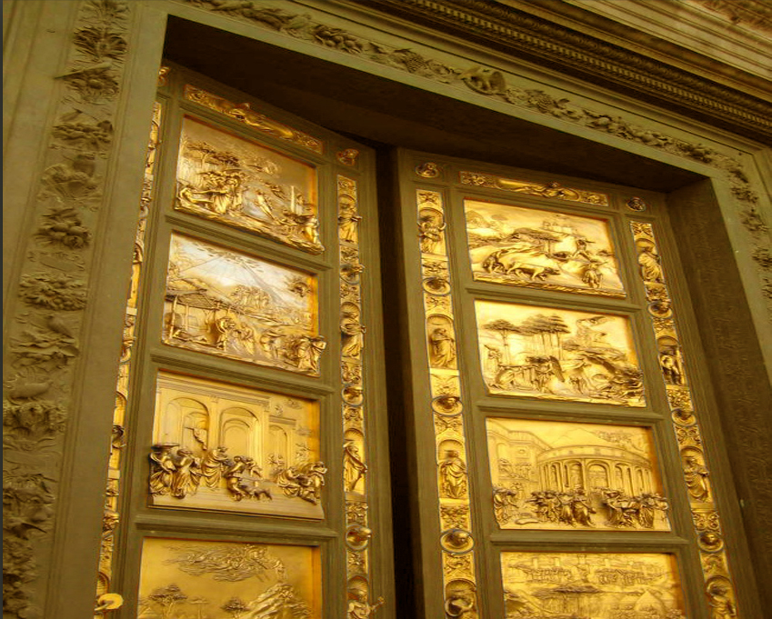
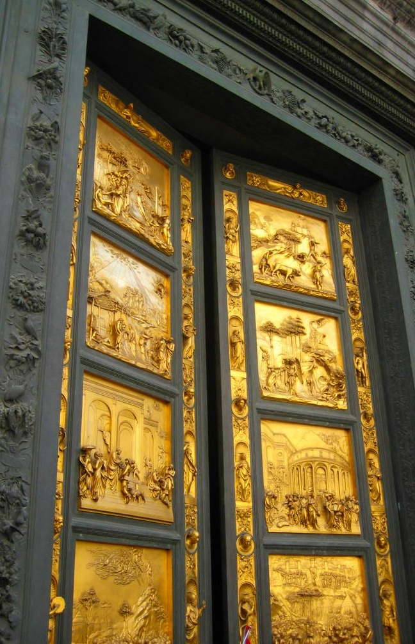
Testimonies
Two Types:
The Beginning
Of our Walk with the Lord
This Week
Our walk with the Lord
Look into Old Testament examples
Look into New Testament examples

Slide 3
What is A Testimony?
that which we have seen and heard we declare to you, that you also may have fellowship with us;
and truly our fellowship is with the Father
and with His Son Jesus Christ.
1 John 1:3

Slide 4
The Testimony What we speak
Always be prepared to give an answer to everyone who asks you to give the reason for the hope that you have. But do this with gentleness and respect
1 Peter 3:15

Slide 5
The Testimony How we speak
Let your speech always be with grace,
seasoned with salt,
that you may know how you ought
to answer each one.
Colossians 4:6

Slide 6
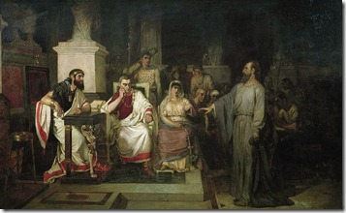
Testimonies from
The New Testament
A Testimony From Paul
Acts 26
Paul

Slide 7
Testimonies from
The New Testament
A Testimony From Paul
Acts 26
Paul

Slide 8
A Testimony from
The New Testament
Introduction of self
Acts 26: 1-11
"I think myself happy"
He was positive.
"You are expert"
He was complimentary.
“You to hear me patiently"
He was humble.

Slide 9
A Testimony from
The New Testament
Before he met Jesus
Acts 26: 1-11
He told his life story.
"My ... life ... was spent ... at Jerusalem.“ Vs. 4
"I lived a Pharisee.“ Vs. 5

Slide 10
A Testimony from
The New Testament
Before He met Jesus
Acts 26: 1-11
"I thought I must do many things contrary to the name of Jesus of Nazareth“ Vs. 9
"Many of the saints I shut up in prison...when they were put to death, I cast my vote against them.“ Vs. 10
I punished them often in every synagogue...compelled them to blaspheme...I persecuted them even to foreign cities.“ Vs. 11

Slide 11
A Testimony from
The New Testament
How He met Jesus
Acts 26: 12-18
"as I journeyed to Damascus ... at midday … along the road." “ Vs. 12
"I saw a light from heaven." Vs. 13
"I heard a voice ... saying in Hebrew ...Saul, Saul, why are you persecuting Me?” Vs. 14

Slide 12
A Testimony from
The New Testament
How He met Jesus
Acts 26: 12-18
"Who are you Lord?' And He said, I am Jesus, whom you are persecuting.” Vs. 15
“…to whom I now send you, to open their eyes, in order to turn them from darkness to light, and from the power of Satan to God, that they may receive forgiveness of sins and an inheritance among those who are sanctified by faith in Me.” Vs. 17-18

Slide 13
A Testimony from
The New Testament
Since met Jesus
Acts 26: 19-23
I was not disobedient to the heavenly vision, but declared … that they should repent, turn to God, and do works befitting repentance. Vs.19-20
Therefore, having obtained help from God, to this day I stand, witnessing both to small and great Vs. 22

Slide 14
A Testimony from
The New Testament
Since met Jesus
Acts 26: 19-23
“…that the Christ would suffer, that He would be the first to rise from the dead, and would proclaim light to the Jewish people and to the Gentiles.” Vs.23

Slide 15
Framing our Testimonies
The Timeframes
Before met the Lord
How met the Lord
Since met the Lord

Slide 16
Framing our Testimonies
Before I met the Lord
What caused you to understand your need for Jesus Christ?

Slide 17
Framing our Testimonies
2. How I met the Lord
Recognize rebellion against God
Heard God would forgive because of Jesus
Asked to be forgiven
Asked God to direct my life

Slide 18
Framing our Testimonies
2. How I met the Lord
must be careful not to leave the impression that Christ is a merely a temporal "problem solver" rather than a Savior to those who recognize that they are separated from God because of their sin and who want to be reconciled to Him.

Slide 19
Framing our Testimonies
3. Since I met the Lord
Describe how your coming to Jesus has changed your life with one or two examples

Slide 20
Framing our Testimonies
Areas to Consider
Early childhood conversion
Not remembering date

Slide 21
Framing our Testimonies
The Timeframes
Before met the Lord
How met the Lord
Since met the Lord

Slide 22
Welcome to The Fellowship 01.22.12

