Slide 1
Psalm 91
Thoughts of a Dweller

Slide 2
Psalm 91
Look for Pronoun Changes
I You I

Slide 3
Psalm 91:1
He who dwells in the secret place of the Most High
Shall abide under
the shadow of the Almighty

Slide 4
Psalm 91:1
He who DWELLS in the
secret place of the Most High
Shall ABIDE under
the shadow of the Almighty

Slide 5
Psalm 91:1
He who dwells in the secret place of the Most High
Shall abide under
the shadow of the Almighty

Slide 6
Psalm 91:2
I will say of the Lord,
“He is my refuge and my fortress; My God, in Him I will trust.”

Slide 7
Psalm 91:2
I will say of the Lord,
“He is my refuge and my fortress; My God, in Him I will trust.”

Slide 8
Psalm 91:2
I will say of the Lord,
“He is my refuge and my fortress; My God, in Him I will trust.”

Slide 9
The Fortress
Elyon – Most High - Possession
Shaddai – Almighty - Provision
Yahweh – Lord - Promise
Elohim – Creator God - Power
Notes:
27,000 Times

Slide 10
Psalm 91:3
Surely He shall deliver you from
the snare of the fowler
and from the perilous pestilence.

Slide 11
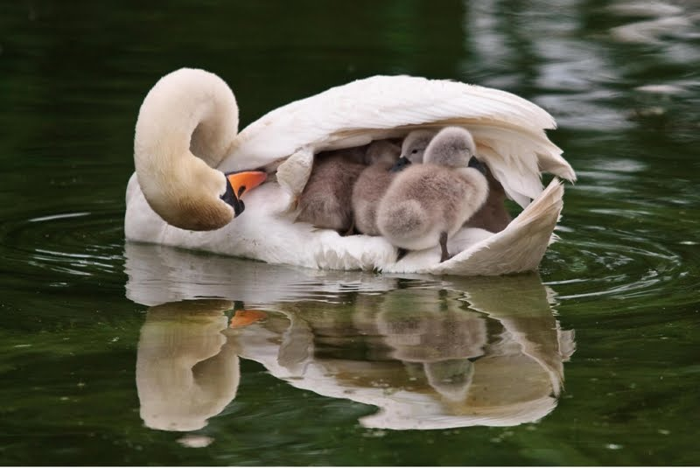
Psalm 91:4a
He shall cover you with His feathers,
And under His wings you shall take refuge;

Slide 12
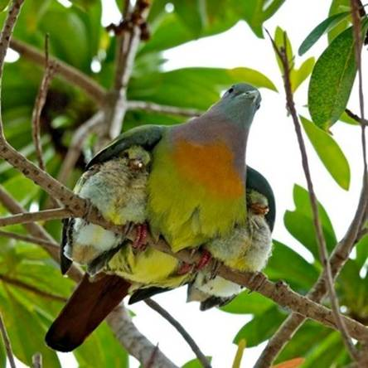
Psalm 91:4a
He shall cover you with His feathers,
And under His wings you shall take refuge;

Slide 13
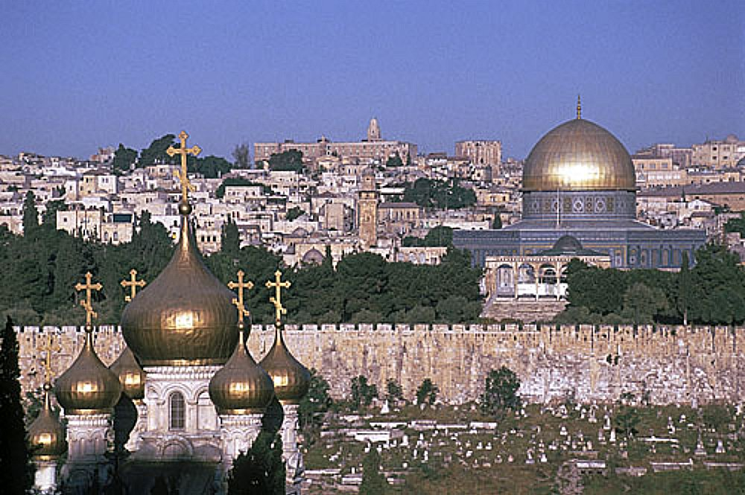
Luke 13:34
O Jerusalem, Jerusalem,
How often I wanted to gather
your children together,
as a hen gathers her brood under her wings,
but you were not willing!

Slide 14
Psalm 91:4b
His truth shall be your shield and buckler

Slide 15
Psalm 91:5-6
You shall not be afraid of the terror by night, Nor of the arrow that flies by day, Nor of the pestilence that walks in darkness, Nor of the destruction that lays waste at noonday.

Slide 16
Psalm 91:7-8
A thousand may fall at your side,
And ten thousand at your right hand;
But it shall not come near you.
Only with your eyes shall you look,
And see the reward of the wicked.

Slide 17
Psalm 91:14-17
Because he has set his love upon Me, therefore I will deliver him; I will set him on high,
Because he has known My name. He shall call upon Me, and I will answer him; I will be with him in trouble; I will deliver him and honor him. With long life I will satisfy him, And show him My salvation.

Slide 18
Because he has set his love upon Me
How do we set our love upon God?
1 John 2:15-17 - A Negative Directive
Do not love the world
or the things in the world.
If anyone loves the world,
the love of the Father is not in him.

Slide 19
Because he has set his love upon Me
How do we set our love upon God?
1 John 2:15-17
¹⁶ For all that is in the world
the lust of the flesh,
the lust of the eyes,
and the pride of life
is not of the Father but is of the world.

Slide 20
Because he has set his love upon Me
How do we set our love upon God?
1 John 2:15-17
¹⁷ And the world is passing away,
and the lust of it;
but he who does the will of God
abides forever.

Slide 21
Because he has set his love upon Me
How do we set our love upon God?
1 John 2:15-17
¹⁷ And the world is passing away,
and the lust of it;
but he who does the will of God
abides forever.

Slide 22
Because he has set his love upon Me
How do we set our love upon God?
A Positive Directive Matthew 22:37-40
“‘You shall love the Lord your God with all your heart, with all your soul, and with all your mind.
This is the first and great commandment..”

Slide 23
Because he has set his love upon Me
How do we set our love upon God?
A Positive Directive Matthew 22:37-40
And the second is like it:
‘You shall love your neighbor as yourself.’
On these two commandments hang
all the Law and the Prophets.”

Slide 24
Because he has set his love upon Me
How do we set our love upon God?
Move from loving self and the world
To
Loving God and others

Slide 25
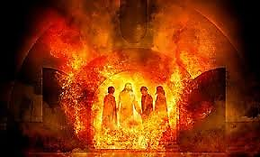
Because he has set his love upon Me 1) Therefore, I will deliver him

Slide 26
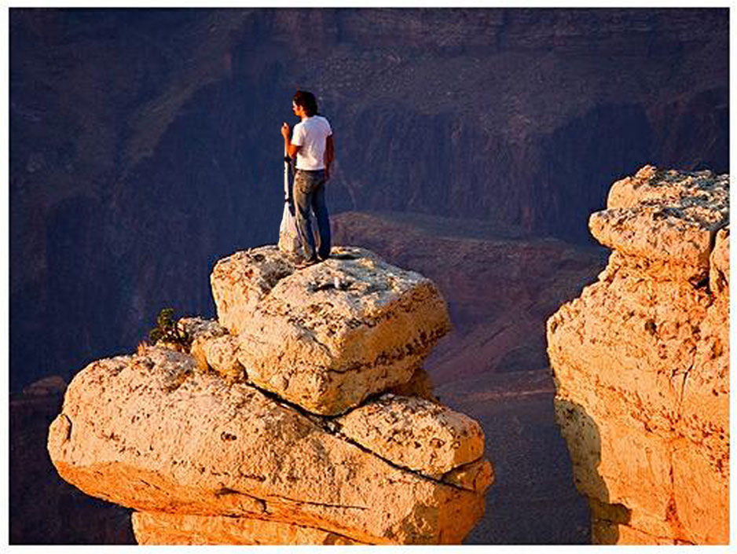
2) I will set him on high, because he has known My name.

Slide 27
He shall call upon Me, 3) and I will answer him;

Slide 28
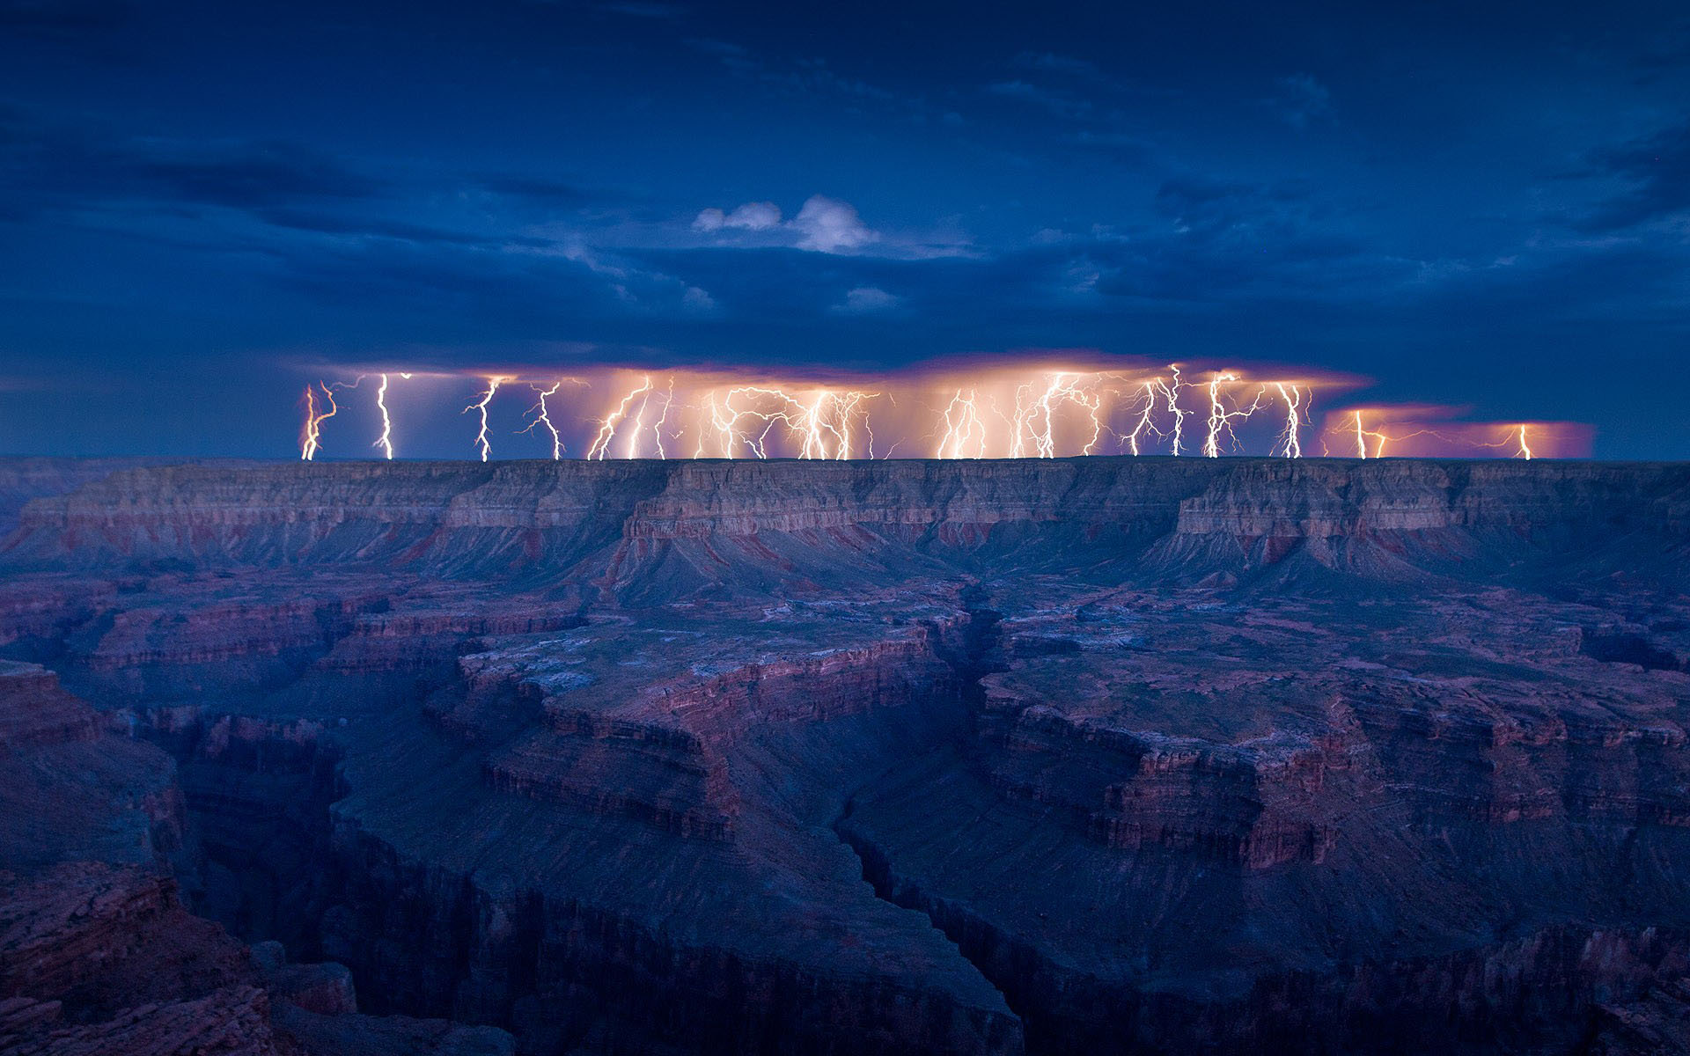
4) I will be with him in trouble;

Slide 29
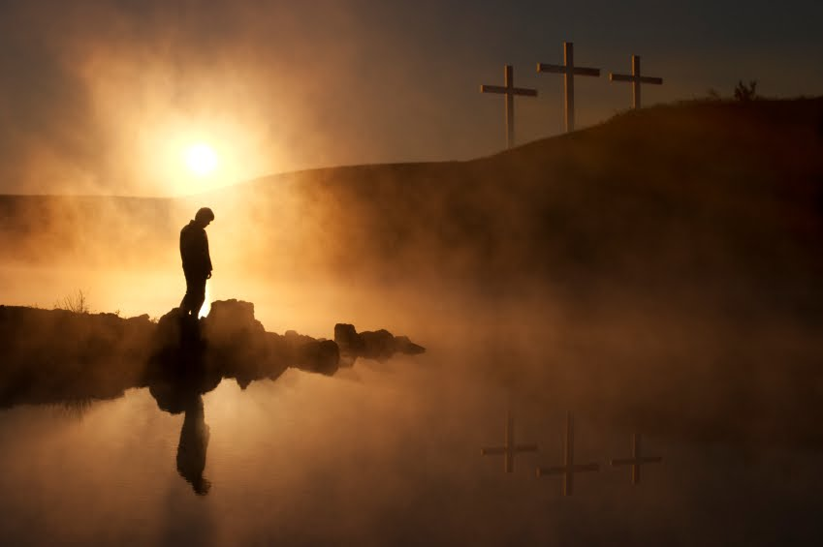
5) I will deliver him and honor him.

Slide 30
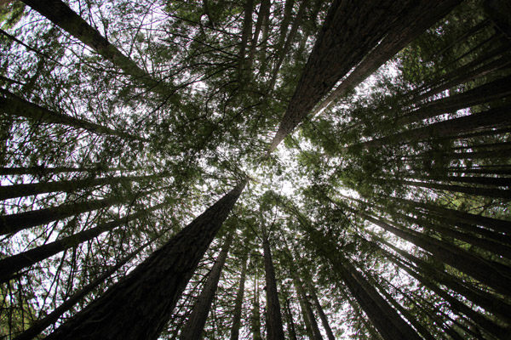
6) With long life I will satisfy him

Slide 31
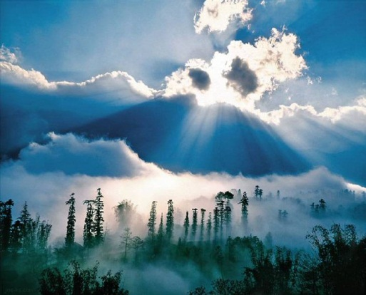
7) And show him My salvation.

