Slide 2
Handling the Burdens of Life
Psalm 55:22

Slide 3
Psalm 55 A Psalm of David
Historical Background 1 Samuel 16
Rebellion of Absalom
Betrayal of Ahithophel

Slide 4
Psalm 55:1-8
The Agony of the Burden
A cry out to God vs. 1-3
Fear within – desire to run away vs. 4-8

Slide 5
Psalm 55:9-15, 20-21
The Situation of the Burden
Deceit in the streets vs. 9-11
Betrayal of a friend vs. 12-15, 20-21

Slide 6
Psalm 55:16-19, 22-23
The Activities in the Burden
Prayer vs. 16-19
Continual
Confident

Slide 7
Psalm 55:16-19, 22-23
The Activities in the Burden
Casting the Burden on the Lord vs. 22-23
Sustained not moved
Defeat of those who against
Trust

Slide 8
The Burdens of Life
Many types and sources
Work, Family, Friends, Finances, World Situation…
OTHERS?

Slide 9
The Burdens of Life
Give them to the Lord
Psalm 55:22

Slide 11
The Burdens of Life
Give them to the Lord
Psalm 55:22
1 Peter 5:6-7

Slide 13
The Burdens of Life
They will work for your good
My brethren, count it all joy when you fall into various trials, knowing that the testing of your faith produces patience. But let patience have its perfect work,
that you may be perfect and complete,
lacking nothing James 1:2-4

Slide 14
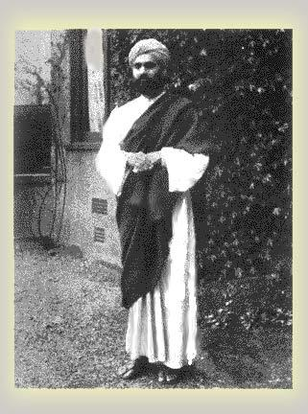
Sadhu Sundar Singh
Came to Jesus from Hinduism
Became missionary
Walking thru Himalayas with a Buddhist monk
Bitter Cold – Must make monastery before dark
Heard cry of a man

Slide 15
Story Slide Hidden
Monk said had to leave him for God had visited his karma and they would die if helped him
Sadhu – God sent me here to help such a one.
Carried him on back to monastery
Made a sling with blanket and tied him on his back and climbed back onto the trail
Saw the lights of the monetary and for the first time stumbled, but not from exhaustion. But over an object.
Bent down brushed snow off and saw the frozen body of then monk he had been walking with before

Slide 16
Sadhu Sundar Singh
Years later a disciple of Sadhu's asked him, "What is life's most difficult task?“
Without hesitation he replied:
"To have no burden to carry."

Slide 18
The Burdens of Life
Can pull you away from the Lord
OR
Draw you to Trust Him more

Slide 19
The Burdens of Life
But I will trust in You.
Psalm 55:23

Slide 20
The Burdens of Life
Satan wants you overwhelmed
by the burdens

Slide 21
The Burdens of Life
Seeking sources apart from God to
meet the needs of the burdens.

Slide 22
The Burdens of Life
But I will trust in You.
Psalm 55:23

